Slide 1
Rockbuster Stealth
Movie Rental Data Presentation
By Brittany Anderson-Freese

Slide 2
Launching an Online Video Rental Service
To remain competitive in the movie rental market against Netflix and Amazon Prime, Rockbuster Stealth can use existing movie licenses to launch an online video rental service
Questions to Consider:
Which countries are Rockbuster customers located in?
Where are customers with a high lifetime value located?
What are the rental rates and durations?
Which movies are most popular?

Slide 3
What the Data Says
Rockbuster Stealth Movies:
Release Years Between 2006-2019
Mode Release Year: 2006
Film Lengths Between 46-185 Minutes
Average Film Length: 115 Minutes
Mode Rating: PG-13
Rental Rates Between $0.99-$4.99
Average Rental Rate: $2.98
Rental Duration Between 3-7 Days
Average Rental Duration: 5 Days

Slide 4
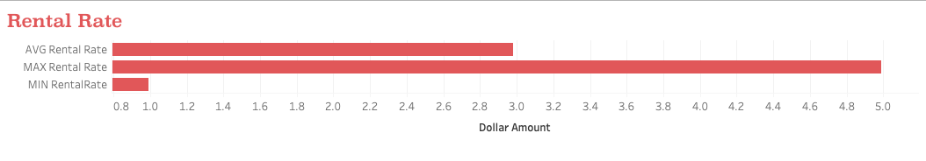
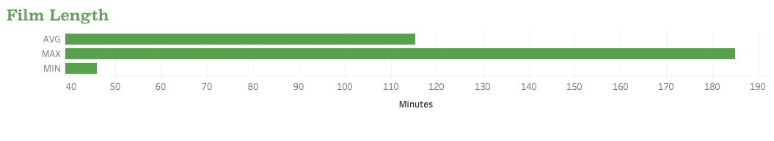

Slide 5
What the Data Says
Rockbuster Customers
Top 10 Countries: India, China, United States, Japan, Mexico, Brazil, Russian Federation, Philippines, Turkey, Indonesia
Top 10 Cities: Aurora, Acua, Citrus Heights, Iwaki, Ambattur, Shanwei, So Leopoldo, Tianjin, Hami, Cianjur
Top Customers Have Paid Between $64.87-$69.86 Total Lifetime

Slide 6
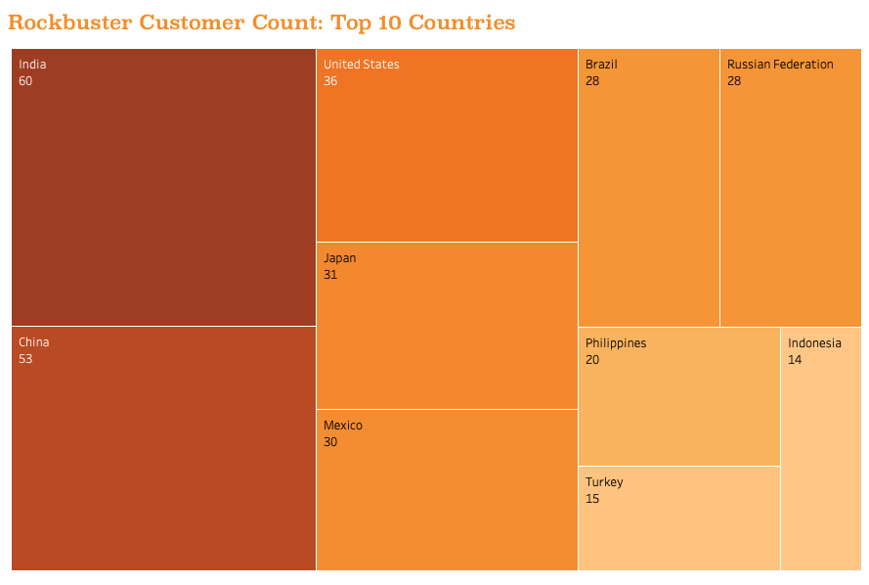


Slide 7
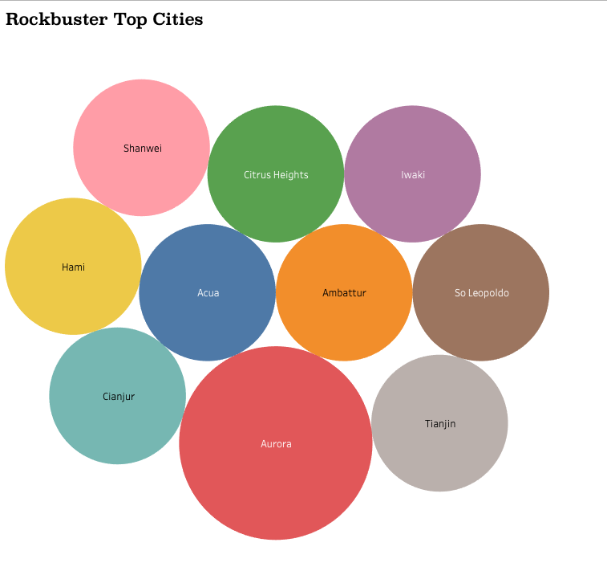

Slide 8
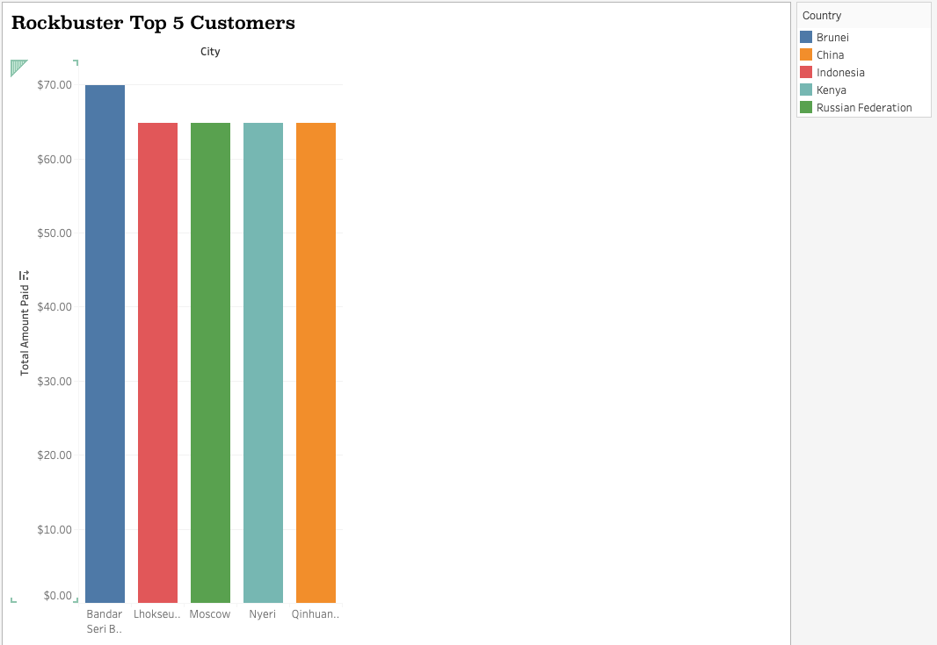

Slide 9
Recommendations
Focus marketing efforts in the most popular countries with the most customers
Determine subscription rate based on average rental rate per film, $2.98
Feature new movies, as well as movies from last 10 years
Feature movies of various lengths and consider the data for average length of rented film - 115 minutes
Complete further analysis to determine more about Rockbuster’s customer base, including average age, most popular genres, ratings, etc. among age groups, etc.

Slide 10
Questions?
See Attachments For More Information
Excel Results and SQL Queries
Data Dictionary

